Slide 1
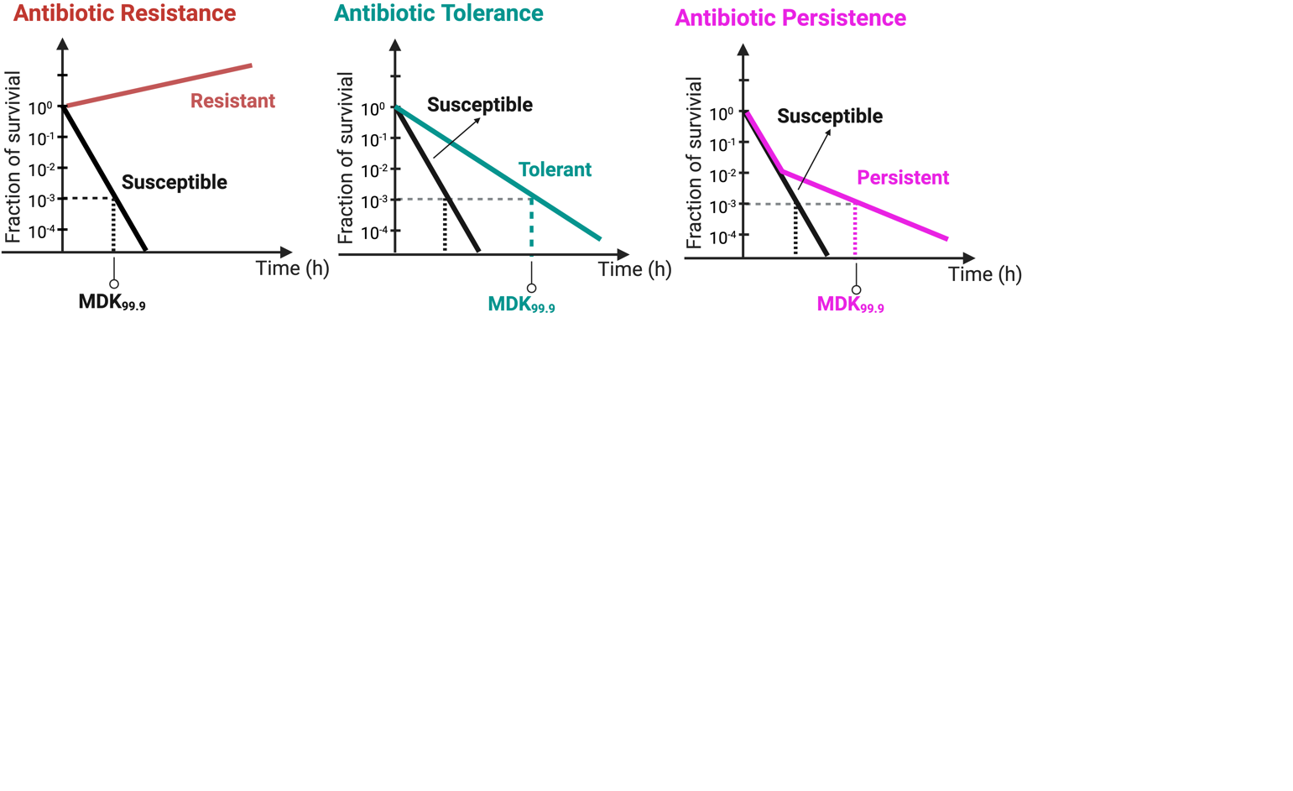
Antibiotic Resistance
Antibiotic Tolerance
Antibiotic Persistence
10⁰
Resistant
10⁰
Susceptible
10⁰
Susceptible
10⁻¹
10⁻¹
10⁻¹
Fraction
Fraction
Tolerant
Fraction
Persistent
10⁻²
Susceptible
10⁻²
10⁻²
10⁻³
10⁻³
10⁻³
10⁻⁴
10⁻⁴
10⁻⁴
Time (h)
Time (h)
Time (h)
MDK_{99.9}
MDK_{99.9}
MDK_{99.9}

